Slide 1
The Elements of Scheme (cont’d.)
A problem arises when data are represented directly in a program, such as a list of numbers
Example: (2.1 2.2 3.1)
  Scheme will try to evaluate it as a function call
  Must prevent this and consider it to be a list literal, using a special form with the keyword quote
Example: (quote (2.1 2.2 3.1))
Rule for evaluating a quote special form is to simply return the expression following quote without evaluating it
Programming Languages, Third Edition

Slide 2
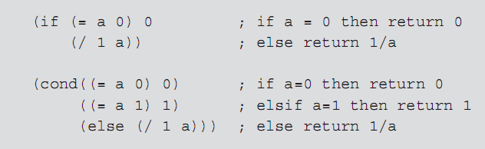
The Elements of Scheme (cont’d.)
Loops are provided by recursive call
Selection is provided by special forms:
  if form: like an if-else construct
  cond form: like an if-elseif construct; cond stands for conditional expression
Programming Languages, Third Edition

Slide 3
The Elements of Scheme (cont’d.)
Neither the if nor the cond special form obey the standard evaluation rule
  If they did, all arguments would be evaluated each time, rendering them useless as control mechanisms
  Arguments to special forms are delayed until the appropriate moment
Scheme function applications use pass by value, while special forms in Scheme and Lisp use delayed evaluation
Programming Languages, Third Edition

Slide 4
The Elements of Scheme (cont’d.)
Special form let: binds a variable to a value within an expression
  Example: (let ((a 2) (b 3)) (+ 1 b))
    First expression in a let is a binding list
let provides a local environment and scope for a set of variable names
  Similar to temporary variable declarations in block-structured languages
  Values of the variables can be accessed only within the let form, not outside it
Programming Languages, Third Edition

Slide 5
The Elements of Scheme (cont’d.)
lambda special form: creates a function with the specified formal parameters and a body of code to be evaluated when the function is applied
  Example:
    (lambda (radius) (* 3.14 (* radius radius)))
  Can apply the function to an argument by wrapping it and the argument in another set of parentheses:
    ((lambda (radius) (* 3.14 (* radius radius))) 10)
  Programming Languages, Third Edition

Slide 6
The Elements of Scheme (cont’d.)
Can bind a name to a lambda within a let:
  (let ((circlearea (lambda (radius) (* 3.14 (* radius radius))))) (circlearea 10))
  let cannot be used to define recursive functions since let bindings cannot refer to themselves or each other
  letrec special form: works like a let but allows arbitrary recursive references within the binding list
  (letrec ((factorial (lambda (n) (if (= n 0) 1 (* n (factorial (- n 1))))))) (factorial 10)
Programming Languages, Third Edition

Slide 7
The Elements of Scheme (cont’d.)
let and letrec forms create variables visible within the scope and lifetime of the let or letrec
define special form: creates a global binding of a variable visible in the top-level environment
Programming Languages, Third Edition

Slide 8
Dynamic Type Checking
Scheme’s semantics include dynamic or latent type checking
  Only values, not variables, have data types
  Types of values are not checked until necessary at runtime
Automatic type checking happens right before a primitive function, such as +
Arguments to programmer-defined functions are not automatically checked
If wrong type, Scheme halts with an error message
Programming Languages, Third Edition

Slide 9
Dynamic Type Checking (cont’d.)
Can use built-in type recognition functions such as number? and procedure? to check a value’s type
  This slows down programmer productivity and the code’s execution speed
Programming Languages, Third Edition

Slide 10
Tail and Non-Tail Recursion
Because of runtime overhead for procedure calls, loops are always preferable to recursion in imperative languages
Tail recursive: when the recursive steps are the last steps in any function
  Scheme compiler translates this to code that executes as a loop with no additional overhead for function calls other than the top-level call
  Eliminates the performance hit of recursion
Programming Languages, Third Edition

Slide 11
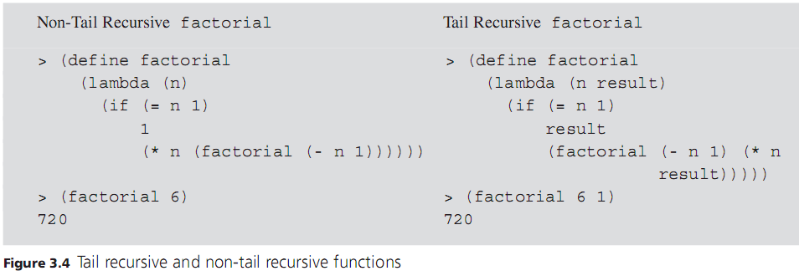
Tail and Non-Tail Recursion (cont’d.)
Programming Languages, Third Edition

Slide 12
Tail and Non-Tail Recursion (cont’d.)
Non-tail recursive function example in Figure 3.4:
  After each recursive call, the value returned by the call must be multiplied by n (the argument to the previous call)
  Requires a runtime stack to track the value of this argument for each call as the recursion unwinds
  Entails a linear growth of memory and a substantial performance hit
Programming Languages, Third Edition

Slide 13
Tail and Non-Tail Recursion (cont’d.)
Tail recursive function example in Figure 3.4:
  All the work of computing values is done when the arguments are evaluated before each recursive call
  Argument result is used to accumulate intermediate products on the way down through the recursive calls
  No work remains to be done after each recursive call, so no runtime stack is necessary to remember arguments of previous calls
Programming Languages, Third Edition

Slide 14
Data Structures in Scheme
Basic data structure in Scheme is the list
  Can represent a sequence, a record, or any other structure
Scheme also supports structured types for vectors (one-dimensional arrays) and strings
List functions:
  car: accesses the head of the list
  cdr: returns the tail of the list (minus the head)
  cons: adds a new head to an existing list
Programming Languages, Third Edition

Slide 15
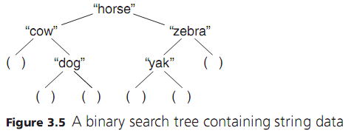
Data Structures in Scheme (cont’d.)
Example: a list representation of a binary search tree
  ("horse" ("cow" () ("dog" () ()))
  ("zebra" ("yak" () ()) () ))
A tree node is a list of three items (name left right)
Programming Languages, Third Edition

Slide 16
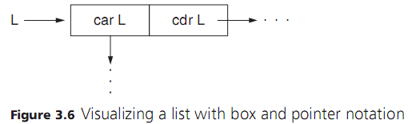
Data Structures in Scheme (cont’d.)
List can be visualized as a pair of values: the car and the cdr
  List L is a pointer to a box of two pointers, one to its car and the other to its cdr
Programming Languages, Third Edition

Slide 17
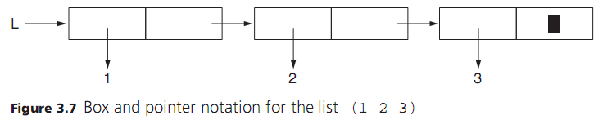
Data Structures in Scheme (cont’d.)
Box and pointer notation for a simple list (1 2 3)
  Black rectangle in the end box stands for the empty list ( )
Programming Languages, Third Edition

Slide 18
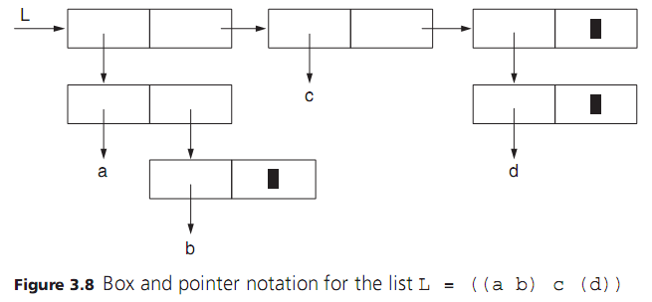
Data Structures in Scheme (cont’d.)
Programming Languages, Third Edition

Slide 19
Data Structures in Scheme (cont’d.)
All the basic list manipulation operations can be written as functions using the primitives car, cdr, cons, and null?
  null? returns true if the list is empty or false otherwise
Programming Languages, Third Edition

Slide 20
Programming Techniques in Scheme
Scheme relies on recursion to perform loops and other repetitive operations
  To apply repeated operations to a list, “cdr down and cons up”: apply the operation recursively to the tail of a list and then use the cons operator to construct a new list with the current result
Example:
(define square-list (lambda (L)
(if (null? L) '()
(cons (* (car L) (car L)) (square-list
(cdr L)))))
Programming Languages, Third Edition

Slide 21
Higher-Order Functions
Higher-order functions: functions that take other functions as parameters and functions that return functions as values
Example: function with a function parameter that returns a function value
(define make-double (lambda (f)
(lambda (x) (f x x)))
Can now create functions using this:
(define square (make-double *))
(define double (make-double +))
Programming Languages, Third Edition

Slide 22
Higher-Order Functions (cont’d.)
Runtime environment of functional languages is more complicated than the stack-based environment of a standard block-structured imperative language
Garbage collection: automatic memory management technique to return memory used by functions
Programming Languages, Third Edition

Slide 23
Static (Lexical) Scoping
Early dialects of Lisp were dynamically scoped
Modern dialects, including Scheme and Common Lisp, are statically scoped
Static scope (or lexical scope): the area of a program in which a variable declaration is visible
  For static scoping, the meaning or value of a variable can be determined by reading the source code
  For dynamic scoping, the meaning depends on the runtime context
Programming Languages, Third Edition

Slide 24
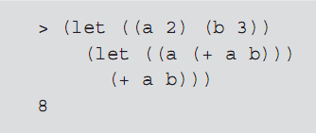
Static (Lexical) Scoping (cont’d.)
Declaration of variables can be nested in block-structured languages
Scope of a variable extends to the end of the block in which it is declared, including any nested blocks (unless it is redeclared within a nesting block)
Programming Languages, Third Edition

Slide 25
Static (Lexical) Scoping (cont’d.)
Free variable: a variable referenced within a function that is not also a formal parameter to that function and is not bound within a nested function
Bound variable: a variable within a function that is also a formal parameter to that function
Lexical scoping fixes the meaning of free variables in one place in the code, making a program easier to read and verify than dynamic scoping
Programming Languages, Third Edition

Slide 26
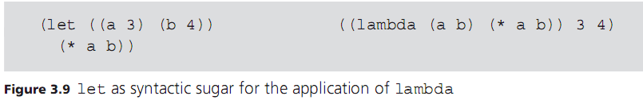
Symbolic Information Processing and Metalinguistic Power
Metalinguistic power: the capacity to build, manipulate, and transform lists of symbols that are then evaluated as programs
Example: let form is actually syntactic sugar for the application of a lambda form to its arguments
Programming Languages, Third Edition

